Slide 1
Replication
Making more DNA
Happens before Mitosis or Meiosis during interphase
Preparation for making new cells
Notes:
Replication – DNA splits in half and nucleotides come in to fill in the blanks. This happens in the nucleus in during Interphase. Accurate replication is important to the correct transmission of traits.

Slide 2
Nucleotide
Hydrogen
Bonds
Sugar-Phosphate
Backbone
KEY
Adenine (A)
Thymine (T)
Cytosine (C)
Guanine (G)
Notes:
We learned about DNA and the basis of its structure when we talked about biological macromolecules, what do you remember? What are the monomers called? What are the parts of the monomer? How do they connect to make a polymer? What are they two types of polymers? The GATC code provides instructions for cell structure and function.

Slide 3
Monomer
Monomer

Slide 4
Notes:
Review nucleotides and why they are important. Name the parts and introduce the four bases (adenine, thymine, guanine, and cytosine).
Line up base pairs and talk about where the connections (bonds) are and how they bond together. Label the parts of the DNA structure (backbone and rungs). Discuss the idea of anti-parallelism that the two strands are opposite to each other. Discuss the length of these molecules and that in the human genome that if all DNA from one cell was lined up end to end it would be 3 meters (over 6 feet) long.

Slide 5
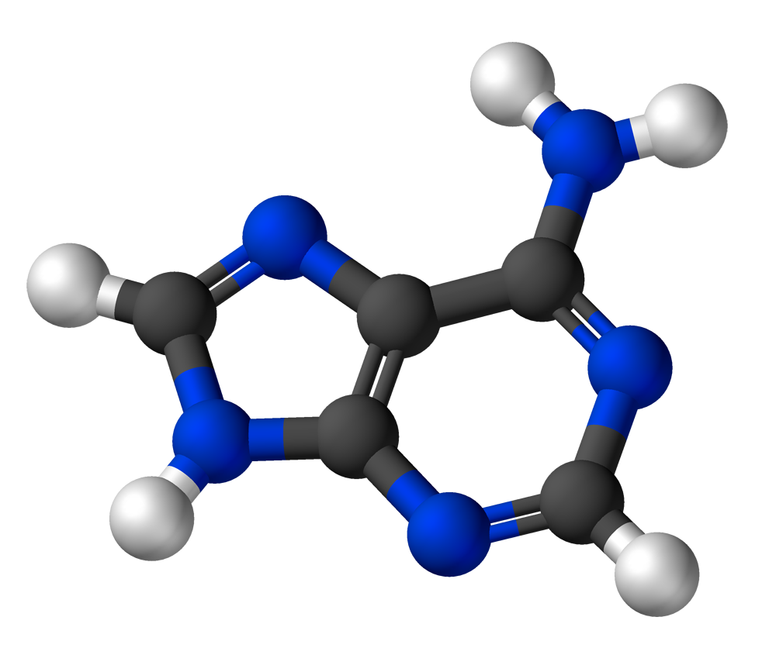
Adenine
Carbon
Nitrogen
Hydrogen

Slide 6
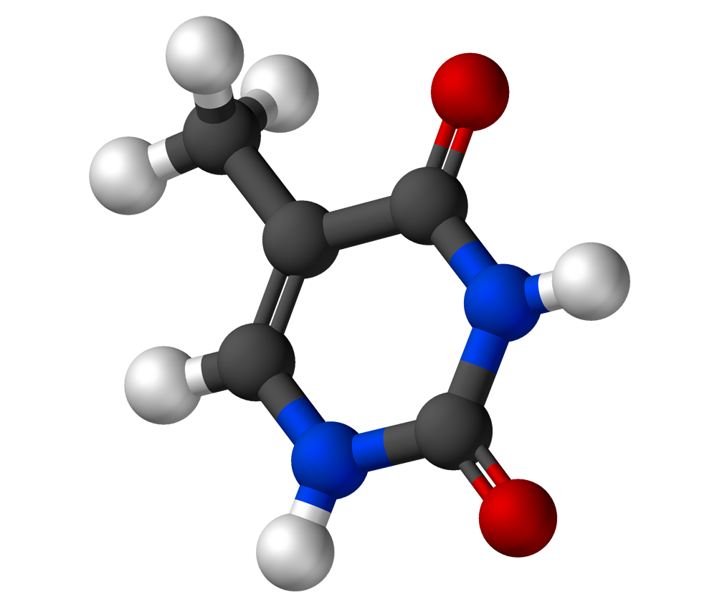
Thymine
Carbon
Nitrogen
Oxygen
Hydrogen

Slide 7
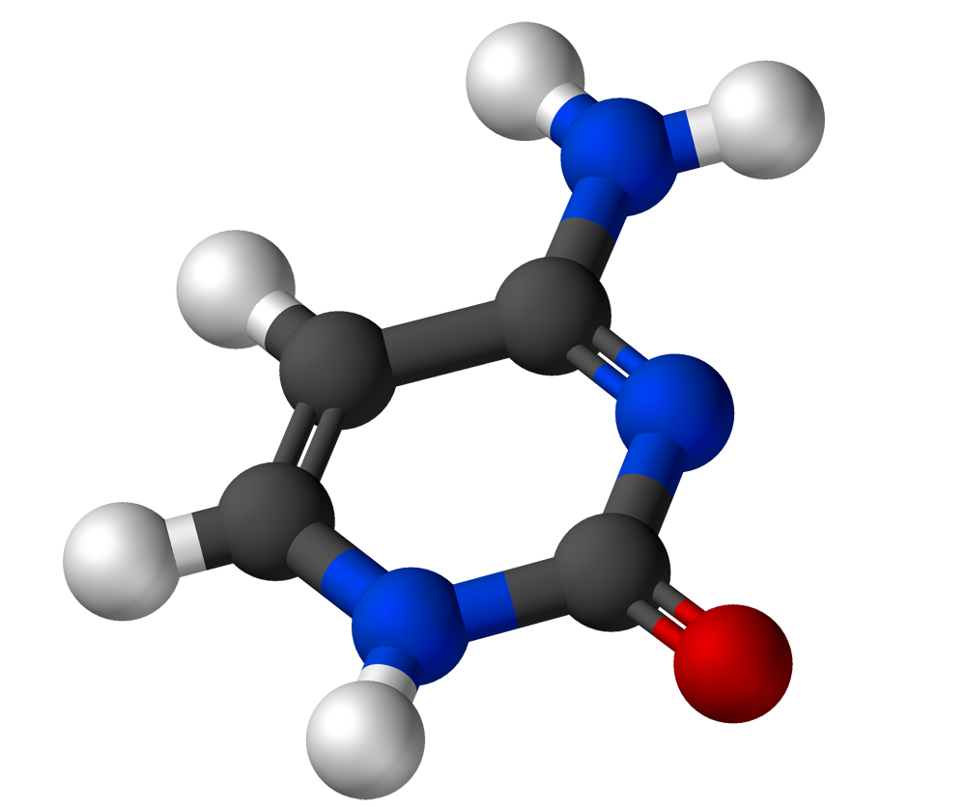
Cytosine
Carbon
Nitrogen
Oxygen
Hydrogen

Slide 8
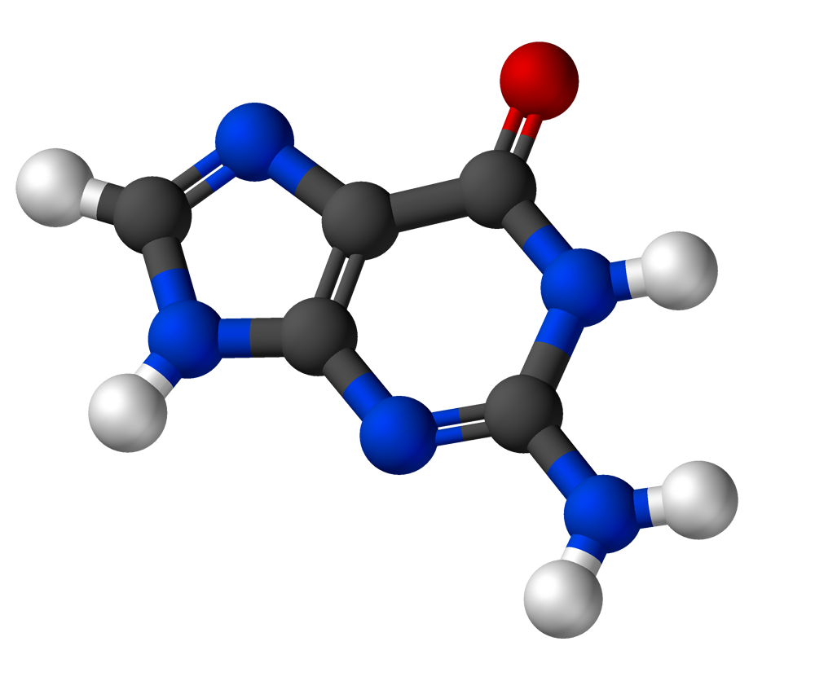
Guanine
Carbon
Nitrogen
Oxygen
Hydrogen

Slide 9
4 Nucleotides
Cytosine-C
Guanine-G
Adenine-A
Thymine-T
Uracil-U (only in RNA)

