Slide 1
CELL CYCLE
Notes:
Interphase:

Slide 2
Preparing for division of nucleus
Preparing for replication
Preparing for cell division
Notes:
Interphase:

Slide 3
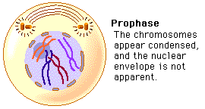
Notes:
Prophase:

Slide 4
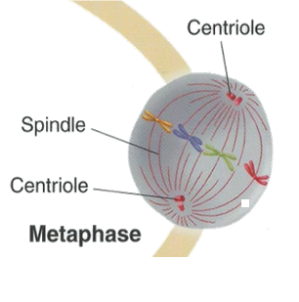
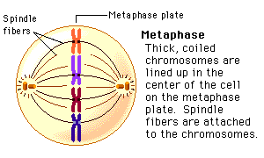
Notes:
Metaphase:

Slide 5
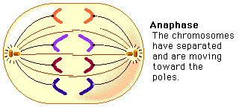
Individual
chromatids
Notes:
Anaphase:

Slide 6
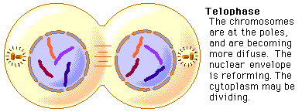
chromatids
Notes:
Telophase:

Slide 7
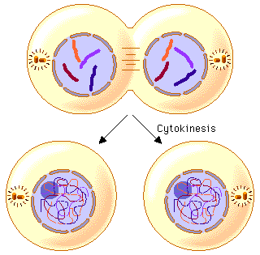
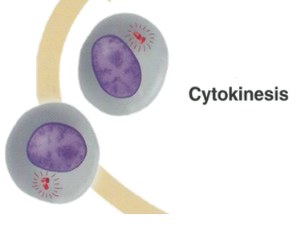
2 daughter cells
Notes:
Cytokinesis: the cytoplasmic division of a cell at the end of mitosis or meiosis, bringing about the separation into two daughter cells.

Slide 9
Notes:
Which four parts are involved in Mitosis? Which two parts are in between Mitosis?

Slide 10
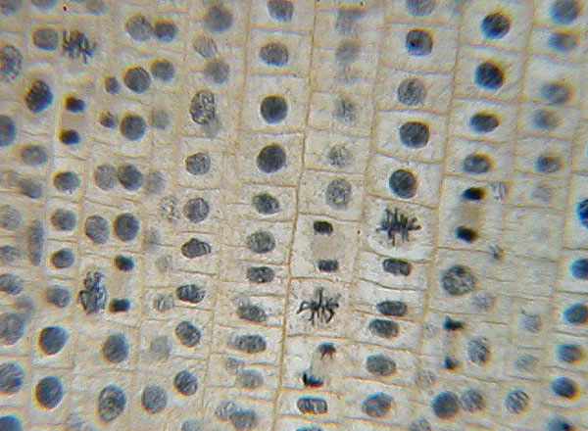
P
I
T
Cell observations
Quiz
M
C
A
Notes:
Order the drawings on the screen in order of their life cycle. Draw the correct order in the life cycle of cells.

