Slide 1
BIO.1:
INTERACTIONS WITH ORGANISMS AND
THE ENVIRONMENT
Notes:
Get out your “Biology Learning Goals (Proficiency Scales)” handout. Find the Bio.1 Standard on page 2.

Slide 2
The cycling of matter and ﬂow of energy are part of a complex system of interactions within an ecosystem. Through these interactions, an ecosystem can sustain relatively stable numbers and types of organisms. A stable ecosystem is capable of recovering from moderate biological and physical changes. Extreme changes may have signiﬁcant impact on an ecosystem's carrying capacity and biodiversity, altering the ecosystem. Human activities can lead to signiﬁcant impacts on an ecosystem, including extinction of species.
Notes:
Read this heading silently to yourself (it’s also on your handout). Underline any phrases or words you do not understand.

Slide 3
I can plan and carry out an investigation to analyze and interpret data to determine how biotic and abiotic factors can aﬀect the stability and change of a population.
Notes:
Read this heading silently to yourself (it’s also on your handout). Underline any phrases or words you do not understand.

Slide 4
I can use data to show stability and change in a population’s carrying capacity and an ecosystem's biodiversity.
Notes:
Read this heading silently to yourself (it’s also on your handout). Underline any phrases or words you do not understand.

Slide 5
Learning Goal #1 BIO.1: INTERACTIONS WITH ORGANISMS AND THE ENVIRONMENT The cycling of matter and ﬂow of energy are part of a complex system of interactions within an ecosystem. Through these interactions, an ecosystem can sustain relatively stable numbers and types of organisms. A stable ecosystem is capable of recovering from moderate biological and physical changes. Extreme changes may have signiﬁcant impact on an ecosystem's carrying capacity and biodiversity, altering the ecosystem. Human activities can lead to signiﬁcant impacts on an ecosystem, including extinction of species.
Level 3 – Proficient: I consistently demonstrate an understanding of concepts, skills, and/or processes of Biology Standard 1. I can plan and carry out an investigation to analyze and interpret data to determine how biotic and abiotic factors can aﬀect the stability and change of a population. [Std 1.1] I can use data to show stability and change in a population’s carrying capacity and an ecosystem's biodiversity. [Std 1.1]
Notes:
Now write down all questions you may have. Ask about what you’re supposed to know; what things mean; how and where you’re going to find the information, etc. Be specific. Give students five minutes to write, then have them share their questions. Write them on the whiteboard.
What is “biotic?”
What is “abiotic?”
What is “ecosystem?”
What is “carrying capacity?”
What is “stability?”

Slide 6
Write the answer to this question in your lab book:
What is biodiversity?
Notes:
Without looking it up, write your definition of “biodiversity” in your lab book. Watch all the videos and take good notes: biotic/abiotic - examples; ecosystem – draw a picture of our classroom ecosystem, indicate which factors are biotic (“B”) and which are abiotic (“A”); Amoeba Sisters video – draw a food chain, draw an energy pyramid, revise your original definition of biodiversity (revise the original, don’t write an entirely new one).

Slide 7
Raptors

Slide 8
Utah’s Raptor Populations
Plan
Investigate
Analyze data
Determine how
Notes:
HawkWatch Assignment

Slide 9
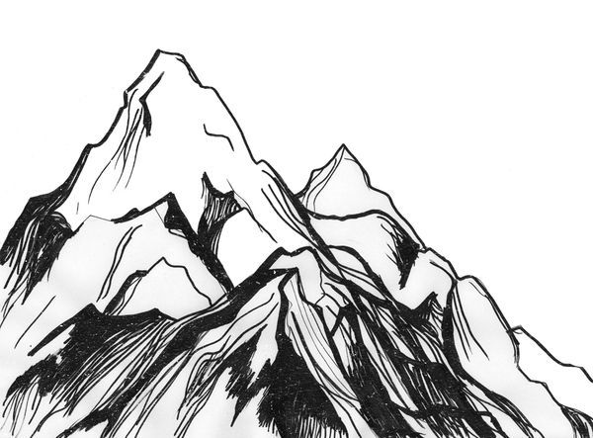
Everest
Notes:
This is Mount Everest. Draw it in front page of lab book. What is your Everest? What do you want to do? Think big. What is the big, huge, wonderful thing you imagine yourself accomplishing or doing or being in your life?

