Slide 1
How To Avoid:

Slide 2
Death by PowerPoint!

Slide 4
Bad PowerPoint Slides:

Slide 10
What’s Wrong With These Slides?

Slide 17
Good PowerPoint Slides:

Slide 21
What’s Right With These Slides?

Slide 24
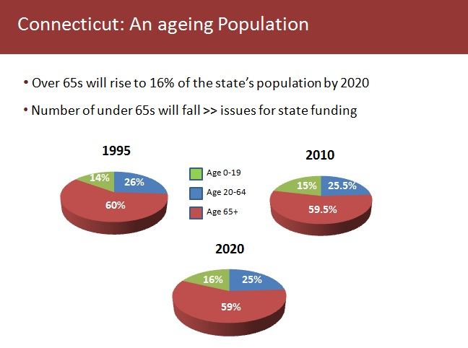

Slide 27
